Slide 1

KNFC Inventory and sales Analysis

Slide 2
OBJECTIVES
Which items are selling the most?
Which items are selling the least?
Are there items we should order soon? How much?
Which items have been in inventory the longest? Especially important for perishables.
What are the Total Sales for the store? What about Total Cost?

Slide 3
APPROACH
To address the questions outlined in the preceding slide, we will use a systematic approach by leveraging various data visualization techniques associated to its specific requirements. We will be using a diverse range of visualization tools including histographs. Through this approach, we aim to extract meaningful and actionable insights from the data, facilitating a comprehensive understanding of the underlying patterns and trends.

Slide 4
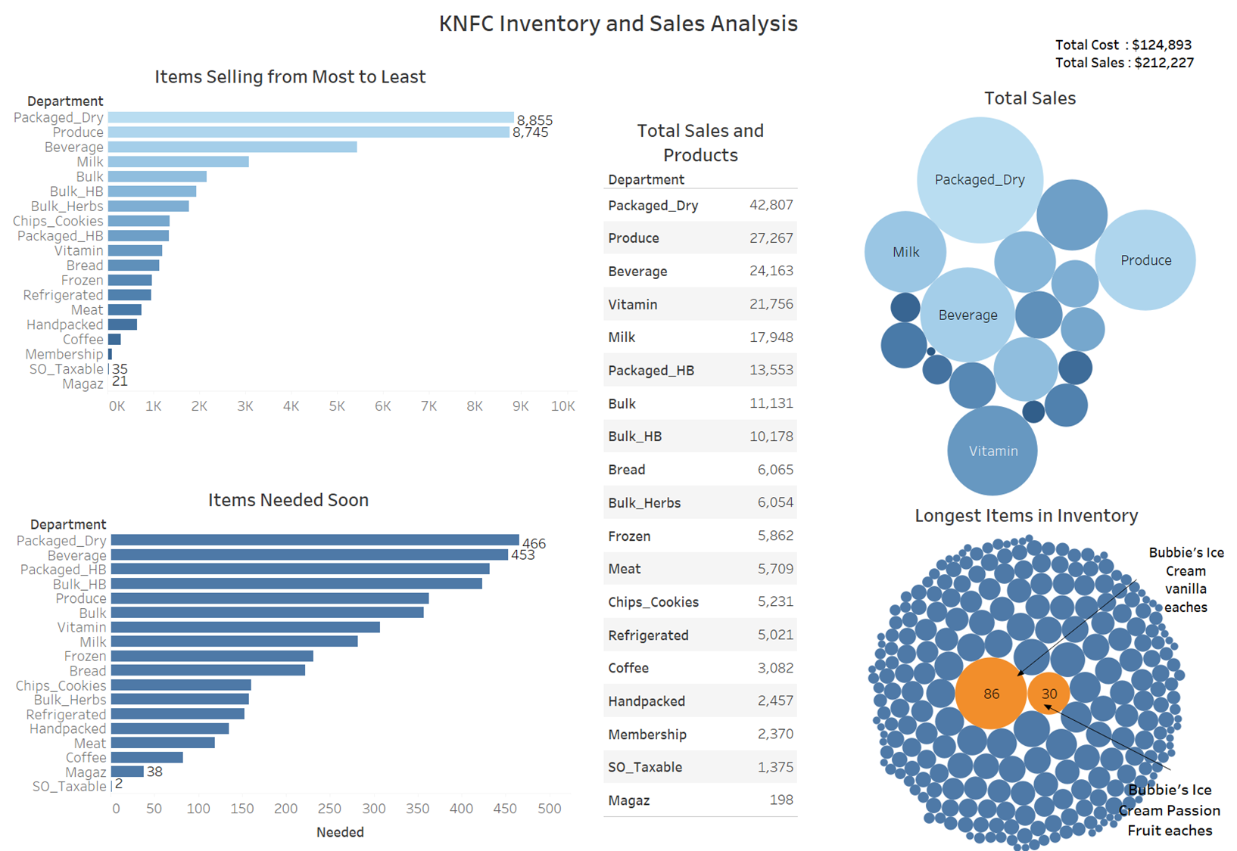

Slide 5
THANK YOU

